Slide 1
Machine learning a impatto sociale
DSS Meetup #33
Talent Garden Genova
27 febbraio 2023

Slide 2

Ing. Andrea Zingoni, PhD
Professor of Computer Science and Artificial Intelligence
Department of Economics, Engineering, Business and Society - University of Tuscia
Co-founder and CEO of U-VI tech.
Innovative startup with high technological vocation
Co-founder and administrator of Tech4All
Innovative startup with high technological vocation, University of Tuscia spinoff
Lorenzo Daidone
Co-founder and CEO of Tech4All s.r.l.
Innovative startup with high technological vocation, University of Tuscia spinoff

Slide 3

VRAILEXIA
PROJECT
IA
PER
IL SOCIALE
2.

Slide 4
PROGETTI IN VIA DI SVILUPPO
PRESSO UNITUS
Map4Accessibility
Creazione di percorsi personalizzati per gli spostamenti di persone con disabilità
BanDoping
Implementazione di un serious game per la sensibilizzazione dei giovani al problema del doping
OLOS
Miglioramento della fruizione museale mediante l’utilizzo dell’olografia
Innovazione delle filiere agricole in senso Industria 4.0
Certificazione della qualità di 4 filiere agricole via blockchain
AI for Nuclear Fusion
Utilizzo di tecniche di machine learning per il miglioramento delle performance dei reattori a fusione
Blockcahin for Football Teams Management
Utilizzo di IA e blockchain per la certificazione delle performance dei calciatori
VRAIlexia

Slide 5
VRAILEXIA
PROJECT
NEL CUORE
DEL PROGETTO
VRAILEXIA
3.
Andrea Zingoni
AIxIA – MLDM2022

Slide 6

VRAILEXIA
PROJECT

Slide 7

VRAILEXIA
PROJECT
VIRTUAL
REALITY
ARTIFICIAL
INTELLIGENCE
+
applied
to support
DYSLEXIA
3-years project
(1 year left)

Slide 8
VRAILEXIA
PROJECT
PROVIDE UNIVERSITY STUDENTS WITH DYSLEXIA
WITH PERSONALIZED DIGITAL TOOLS AND LEARNING STRATEGIES,
DURING THEIR ACADEMIC CAREER,
BY EXPLOITING THE POTENTIAL OF ON-THE-EDGE TECHNOLOGIES,
LIKE ARTIFICIAL INTELLIGENCE AND VIRTUAL REALITY

Slide 9
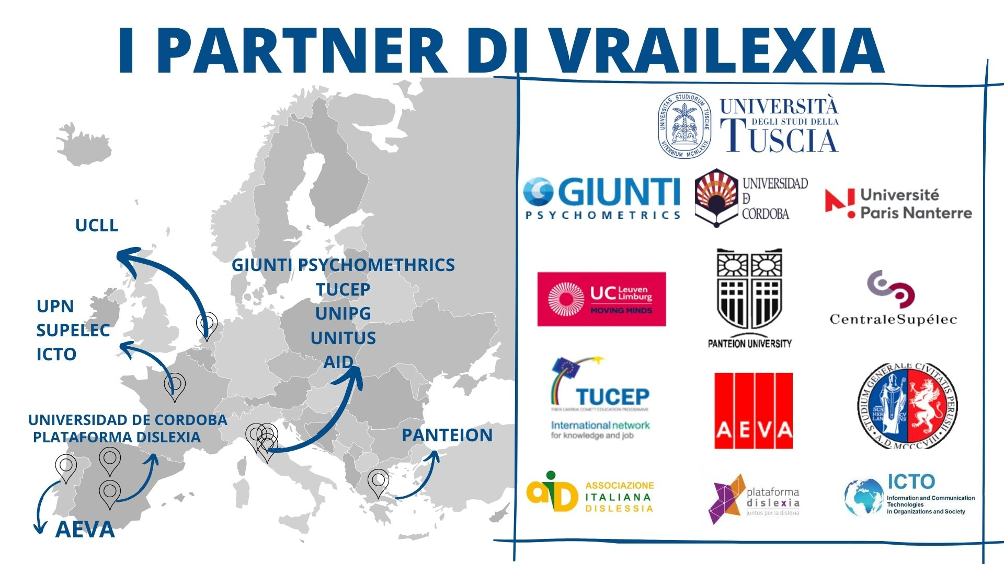
VRAILEXIA
PROJECT
Co-funded by
the Erasmus+ Programme
of European Union

Slide 10


VRAILEXIA
PROJECT
IRCAI (UNESCO) Award
World TOP100 Projects
based on AI
for the aims of agenda 2030
EVALUATION: EXCELLENT
Approved for
Repubblica Digitale Network
promoted by
Italian Ministry of Technological Innovation and Digital Transition

Slide 11





VRAILEXIA
PROJECT
GOALS
Virtualization of classic psychometric tests (Rosenberg, Silent Reading…)
Development of 2 VR tools:
«In the shoes of dyslexics», VR application to simulate the difficulties encountered by students with dyslexia and make users awared of them
Development of BESPECIAL platform (based on VR and AI), to provide customized support to students
Release of an Open Repository, containing study and forming material for students and teachers, respectively, based on the UDL.
Creation and testing of specific training path for teachers (about UDL principles) and for students (with an entrepreneurial approach)
Creation of a Campus Network to share results and good practices, through the signing of a Memorandum of Understanding

Slide 12
BACKGROUND AND RATIONALE
VRAILEXIA
PROJECT
?
?
?
?
?
WHAT IS DYSLEXIA?
DEFINITION:
Learning difficulty
that primarily affects the skills
of accurately and fluently reading and spelling
(WHO)

Slide 13
BACKGROUND AND RATIONALE
VRAILEXIA
PROJECT
?
?
?
?
?
WHAT IS DYSLEXIA?
MATTERS OF FACT:
80% probability of comorbidity with other SLD
Results in memorization, taking notes, concentration and expression difficulties
Generate anxiety, lack of self-esteem and of motivation
Not caused by sensorial or intelligence deficits
Results in creative ways of learning

Slide 14
BACKGROUND AND RATIONALE
VRAILEXIA
PROJECT
Number of people with Specific Learning Disorders
over all the world population
~ 480 millions
~ 1,6 billions

Slide 15
BACKGROUND AND RATIONALE
VRAILEXIA
PROJECT
Percentage of people with dyslexia
over all people with Specific Learning Disorders
DYSLEXIA + OTHER POSSIBLE SLD
Dyslexia is
the most common
disorder among
all the SLDs
ONLY DYSLEXIA

Slide 16
BACKGROUND AND RATIONALE
VRAILEXIA
PROJECT
Students with SLD in Italy
High School
Missed Enrollments
or
Abandonments
at University
University
Source: Italian Ministry of Education 2019

Slide 17
BACKGROUND AND RATIONALE
VRAILEXIA
PROJECT
Average number of ECTS achieved in 1 year
Source: UNITUS internal survey
HUMANITIES
GLOBAL
SCIENCES
About 1 exam less
in 1 year
Greater difficulties
in Humanities
NO
SI
Presenza di dislessia
NO
SI
NO
SI

Slide 18
VRAILEXIA
PROJECT
BESPECIAL PLATFORM

Slide 19

VRAILEXIA
PROJECT
BESPECIAL PLATFORM
Input
1. Self-evaluation QUESTIONNAIRE about issues encountered
while studying and most effective support tools and strategies
DEMOGRAPHIC QUESTIONS
(age, gender,
attended schools…)
12 ISSUES
(concentration, text understanding, memorization…)
DYSLEXIA HISTORY QUESTIONS
(diagnosis age,
received support…)
17 DIGITAL TOOLS
(vocal assistant, conceptual maps, word-image association…)
QUESTIONS ABOUT ISSUES AND NEEDS RELATED TO DYSLEXIA
22 LEARNING STRATEGIES
(tutor, only oral/written exams, split courses in different modules…)

Slide 20
VRAILEXIA
PROJECT
BESPECIAL PLATFORM
Input
2. CLINICAL REPORT about presence and status of dyslexia, produced from experts’ qualitative evaluation
INFORMATION RETRIEVAL ABOUT ISSUES OF THE STUDENT AND MOST USEFUL SUPPORT METHODOLOGIES

Slide 21
VRAILEXIA
PROJECT
BESPECIAL PLATFORM
Input
3. Classical PSYCHOMETRIC TESTS
used to diagnose dyslexia quantitatively
BDA 16-30
Clinical evaluation of reading, writing and understanding, for adolescents
STAI-Y
Evaluation of the anxiety level, in front of a task to perform
General Self-Efficacy Scale
Evaluation of cognitive and motivational aspects
QPA-D
Evaluation of aspects linked to motivation, meta-cognition, and learning strategies
R-SES
Evaluation of self-esteem and self-acceptance

Slide 22
VRAILEXIA
PROJECT
BESPECIAL PLATFORM
Interface
Questionnaire
hosting and
digitalization
OCR
to digitalize
clinical reports
Delivery
of the tests
via VR

Slide 23
VRAILEXIA
PROJECT
BESPECIAL PLATFORM
Interface
Questionnaire
hosting and
digitalization
OCR
to digitalize
clinical reports
Delivery
of the tests
via VR
Google Vision API
Identification and extraction of text
Tokenization
Stop words removal
Stemming
KEYWORDS
DETECTION

Slide 24
VRAILEXIA
PROJECT
BESPECIAL PLATFORM
Interface
Questionnaire
hosting and
digitalization
OCR
to digitalize
clinical reports
Delivery
of the tests
via VR
OFFERING AN ENGAGING EXPERIENCE
€
!
🙂
DVR
IVR
€€€
!!!
🤩

Slide 25
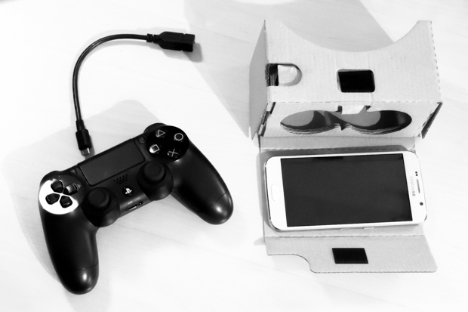

VRAILEXIA
PROJECT
BESPECIAL PLATFORM
Interface
Questionnaire
hosting and
digitalization
OCR
to digitalize
clinical reports
Delivery
of the tests
via VR

Slide 26
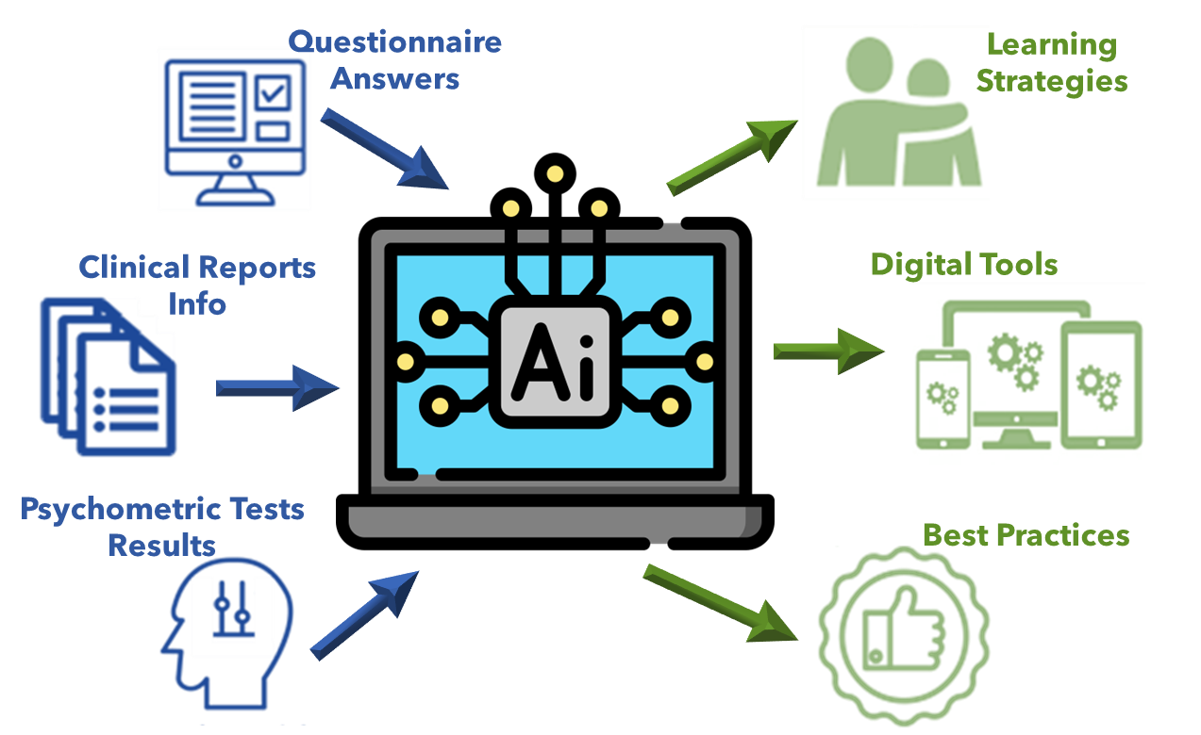
VRAILEXIA
PROJECT
BESPECIAL PLATFORM
AI assessment module
Customized
for each student
PREDICTION

Slide 27
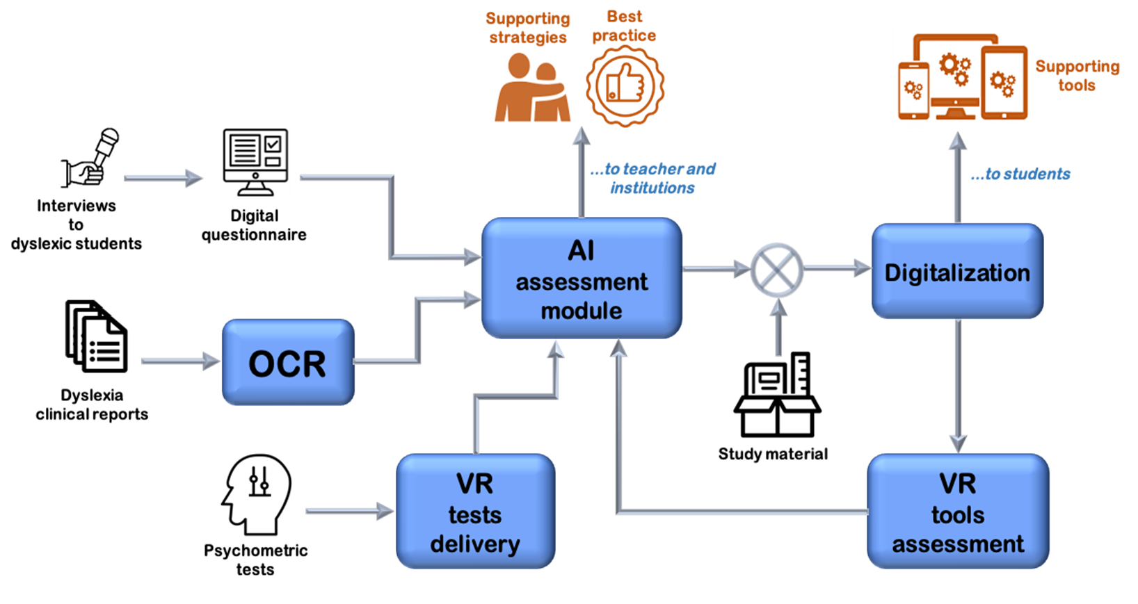

VRAILEXIA
PROJECT
BESPECIAL PLATFORM
AI assessment module
Best Practices Prediction
Detection of
typological groups
of dyslexic students
Creation of
Good Practices
to support them
Demographic Data
Hierarchical Clustering
Algorithm
+
Profiling
Psychometric Tests Results

Slide 28

VRAILEXIA
PROJECT
BESPECIAL PLATFORM
AI assessment module
Learning Strategies and Digital Tools Prediction
DATA DRIVEN
AI
DATA DRIVEN
AI
Students’ Issues
+
Students’ Needs
Data
+
Psychometric Tests Results
HUMAN DRIVEN
AI
HUMAN DRIVEN
AI
Corpus of knowledge
About Dyslexia
Prediction of
Personalized Support
Learning Strategies
Prediction of
Personalized Support
Digital Tools

Slide 29
VRAILEXIA
PROJECT
BESPECIAL PLATFORM
AI assessment module
Data + Human Driven AI
Cut wrong links
among issues/needs
of the students
DATA DRIVEN
AI
HUMAN DRIVEN
AI
Machine Learning
Algorithms Suite
Knowledge-Integrated
Informed AI
Tools/Strategies
Ensemble ML
Predictor
from student needs
Recommendation System
for Tools/Strategies
Find Invariances
into the relations
among issues and needs of the students

Slide 30
VRAILEXIA
PROJECT
BESPECIAL PLATFORM
Output
…to teachers
and institution
…to students
Learning
Strategies
Best Practices
AI
Digital Tools
Prediction
Digital Tools
Study Material

Slide 31


VRAILEXIA
PROJECT
BESPECIAL PLATFORM
VR evaluation module
Student experience
of Digital Tools
Performance Indicators
for each student
CATEGORY-SPECIFIC TOOLS
STUDENT-SPECIFIC TOOLS
AIxIA – MLDM2022

Slide 32
VRAILEXIA
PROJECT
BESPECIAL PLATFORM
VR evaluation module
OFFERING AN ENGAGING EXPERIENCE AND DECREASE BOREDOM
€
!
🙂
DVR
IVR
€€€
!!!
🤩

Slide 33
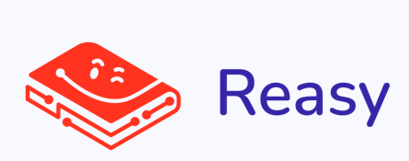

VRAILEXIA
PROJECT
BESPECIAL PLATFORM
by

Slide 34

VRAILEXIA
PROJECT
PRELIMINARY RESULTS
DONE
WORK IN PROGRESS
Dec. 2022

Slide 35
VRAILEXIA
PROJECT
PRELIMINARY RESULTS
Data Collection
Questionnaire
Translated
in all Languages
More than
500 clinical reports
from Italy
More than
1300 answers
in Italian
More than
200 answers
in Spanish
More than
300 answers
in Spanish

Slide 36

VRAILEXIA
PROJECT
PRELIMINARY RESULTS
Statistics
Greater Issues experienced
Best support Tools
Best support Strategies
Concentration
Memorization
(average vote: around 3,5 on a 0 to 5 range)
Schemes, Summaries and conceptual maps
Clear layout of the study material
Pauses during lessons
Material availability
(more useful than tools in average)

Slide 37
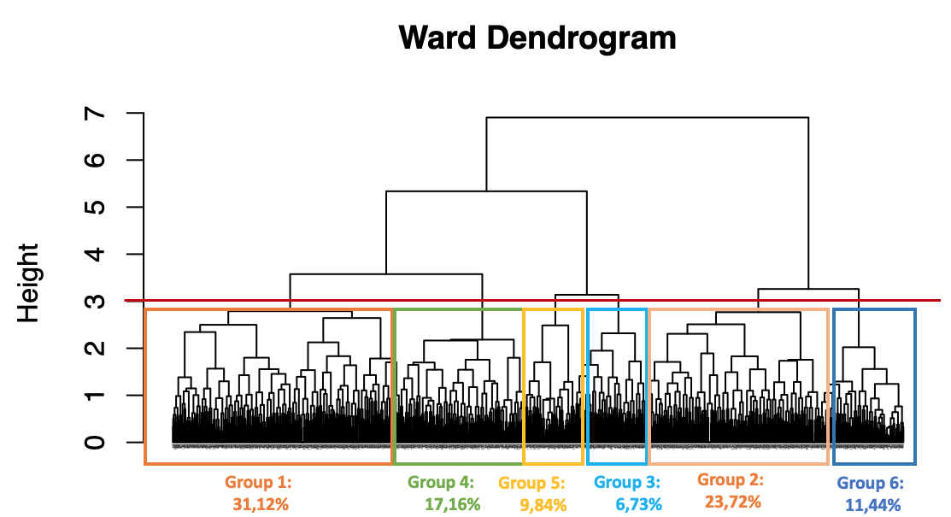
VRAILEXIA
PROJECT
PRELIMINARY RESULTS
Students Clustering and Profiling
Detection of
6
typological groups

Slide 38
VRAILEXIA
PROJECT
PRELIMINARY RESULTS
Students Clustering and Profiling
Born before 1990
Born from 1990 to 1999
Born after 1999
Group 1
- Delayed or abandoned
- Diagnosis 3°-5° year high school
- Repeated years
- No support received
- Relatives with dyslexia
- Other SLDs
Gruppo 3
- Delayed
- Diagnosis 3°-5° year high school
- Repeated years
- Support from parents and tutors
- Relatives with dyslexia
- Other SLDs (dyscalculia)
Gruppo 5
- Part-time students
- Diagnosis primary or secundary school
- Repeated years
- Support from speech therapists and
tutors
- No relatives with dyslexia
- Other SLDs (dysgrafia)
Gruppo 2
- Graduated or finishing university
- Diagnosis at primary school
- No repeated years
- Support from parents
- No relatives with dyslexia
- Aother SLDs
Gruppo 4
- Graduated or half acad. career
- Diagnosis 1°-2° high school
- Repeated years
- Support from dysl. associations
- No relatives with dyslexia
- No other SLDs
Gruppo 6
- High school or beginning univ.
- Diagnosis 1°-2° high school
- Repeated years
- Support from speech therapists and psychologists
- No relatives with dyslexia
- Other SLDs (dysgrafia, dysorthogr.)

Slide 39
VRAILEXIA
PROJECT
PRELIMINARY RESULTS
Students Clustering and Profiling
Group 1
Great difficulties of several kinds (reading, memorization,
concentration, study organization etc.).
Gruppo 2
Some difficulties in concentrating and in following lessons.
Gruppo 3
Great difficulties of several kinds, especially in memorizing and
following lessons
Gruppo 4
Difficulties in following lessons and, partially, in concentrating,
memorzing, and exposition during exams.
Gruppo 5
Great difficulties in concentrating, memorizaing
organizing study and exposition during exams.
Gruppo 6
Partial difficulties of several kind (reading, memorization,
concentration, study organization etc.)

Slide 40
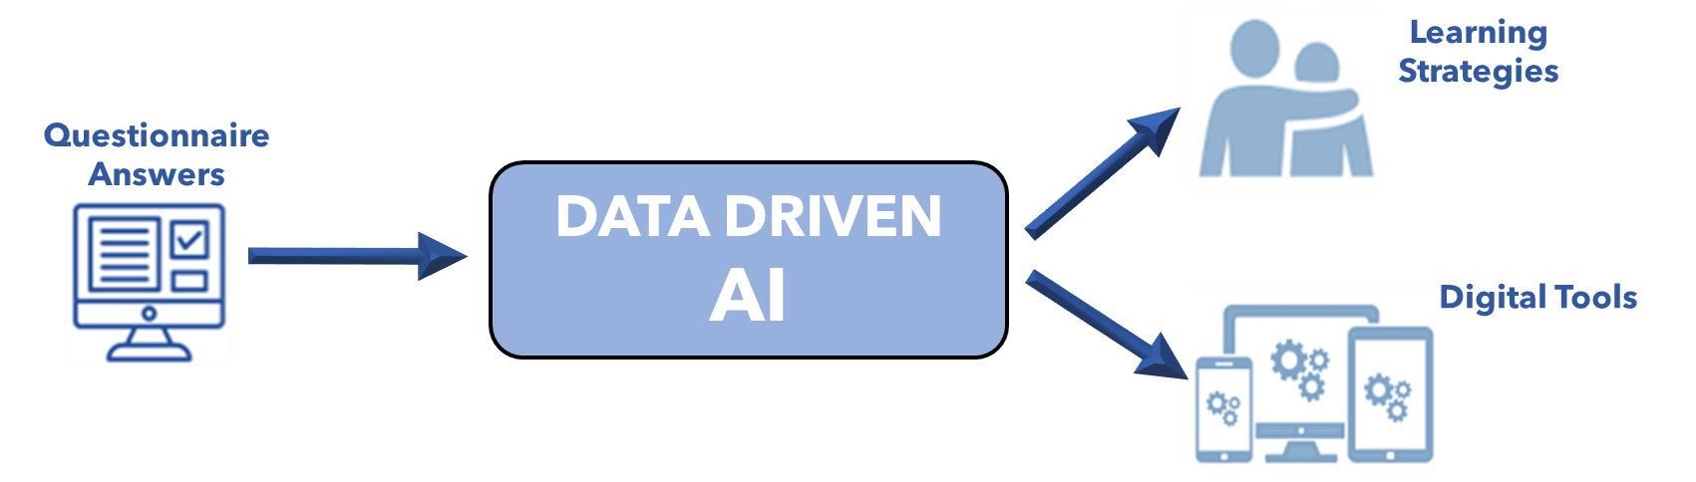
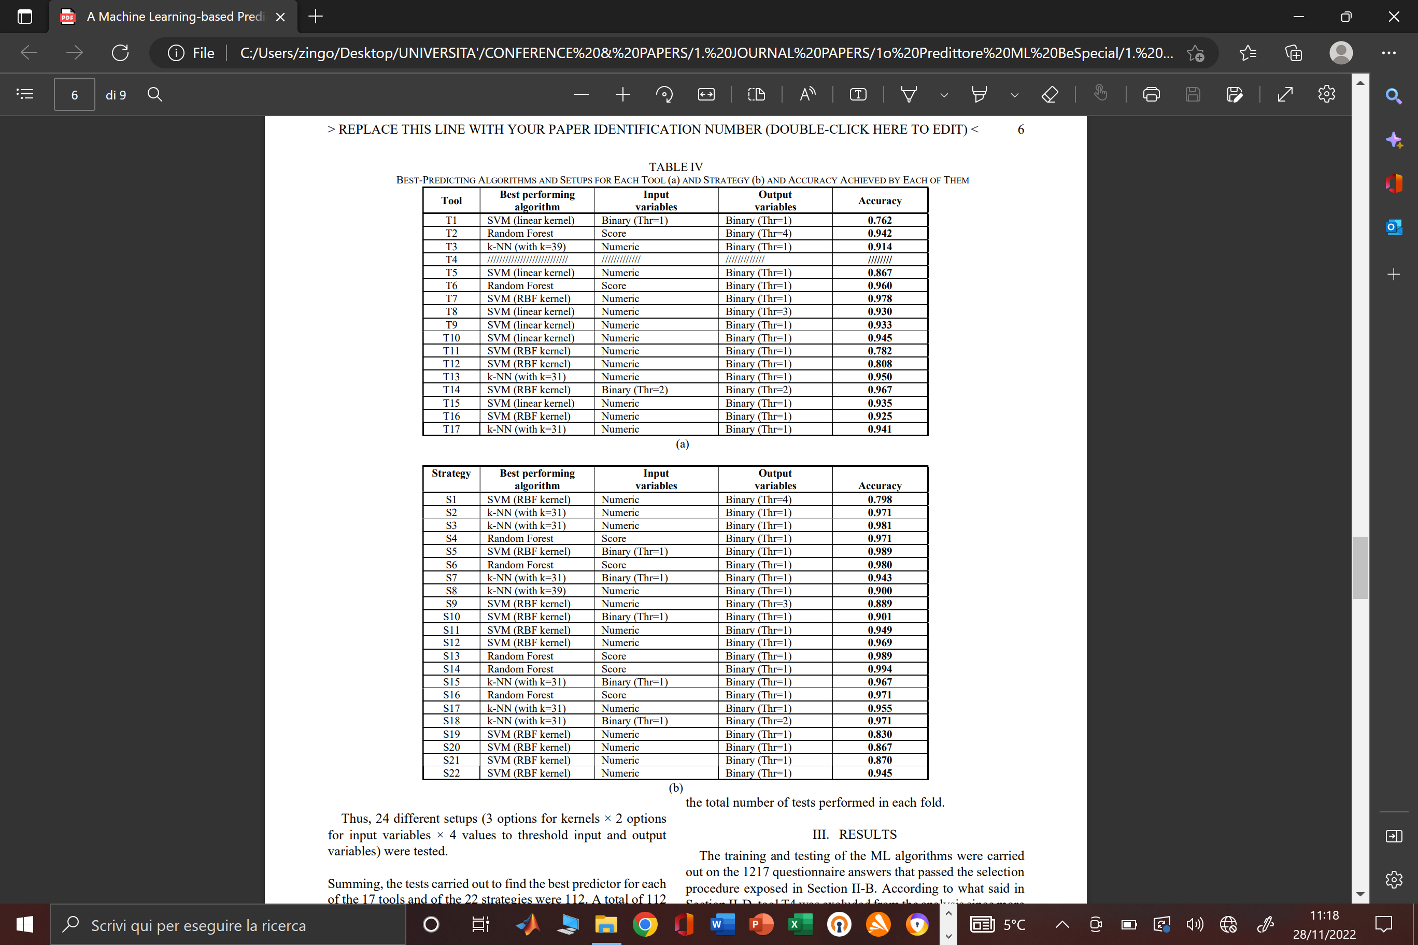
VRAILEXIA
PROJECT
PRELIMINARY RESULTS
Support Tools and Strategies Prediction
PREDICTION
SVM + k-NN + Random Forest
SPECIFIC TUNING
TOOLS ACCURACY PREDICTION = 92,5%
STRATEGIES ACCURACY PREDICTION = 95,4%
[Evento]

Slide 41
VRAILEXIA
PROJECT
PRELIMINARY RESULTS
Support Tools and Strategies Prediction
STUDENT PROFILING
RECOMMENDATION
SYSTEM
Recommended
Tools and Strategies
COLLABORATIVE FILTERING
Hybrid (item/user based) approach
Pearson correlation
AVERAGE RECOMMENDATION ERROR = 0,29/5 =5.8%

Slide 42
LA PIATTAFORMA REASY:
ESEMPIO PRATICO DI UTILIZZO DELL’IA NEL SOCIALE
4.

Slide 43
Reasy

Slide 44



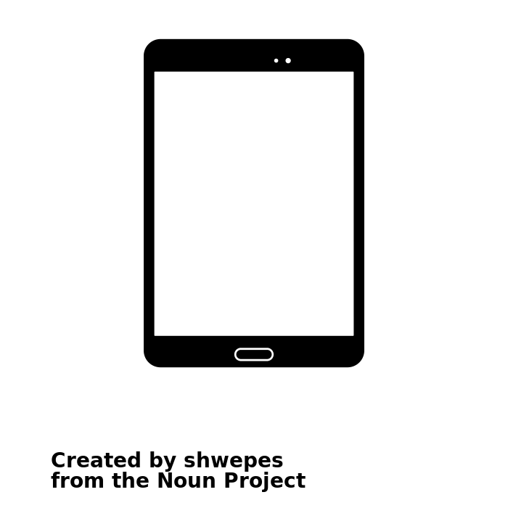
Strumento per l’apprendimento accessibile
degli studenti con Dislessia

Slide 45
Funzionalità

Slide 46
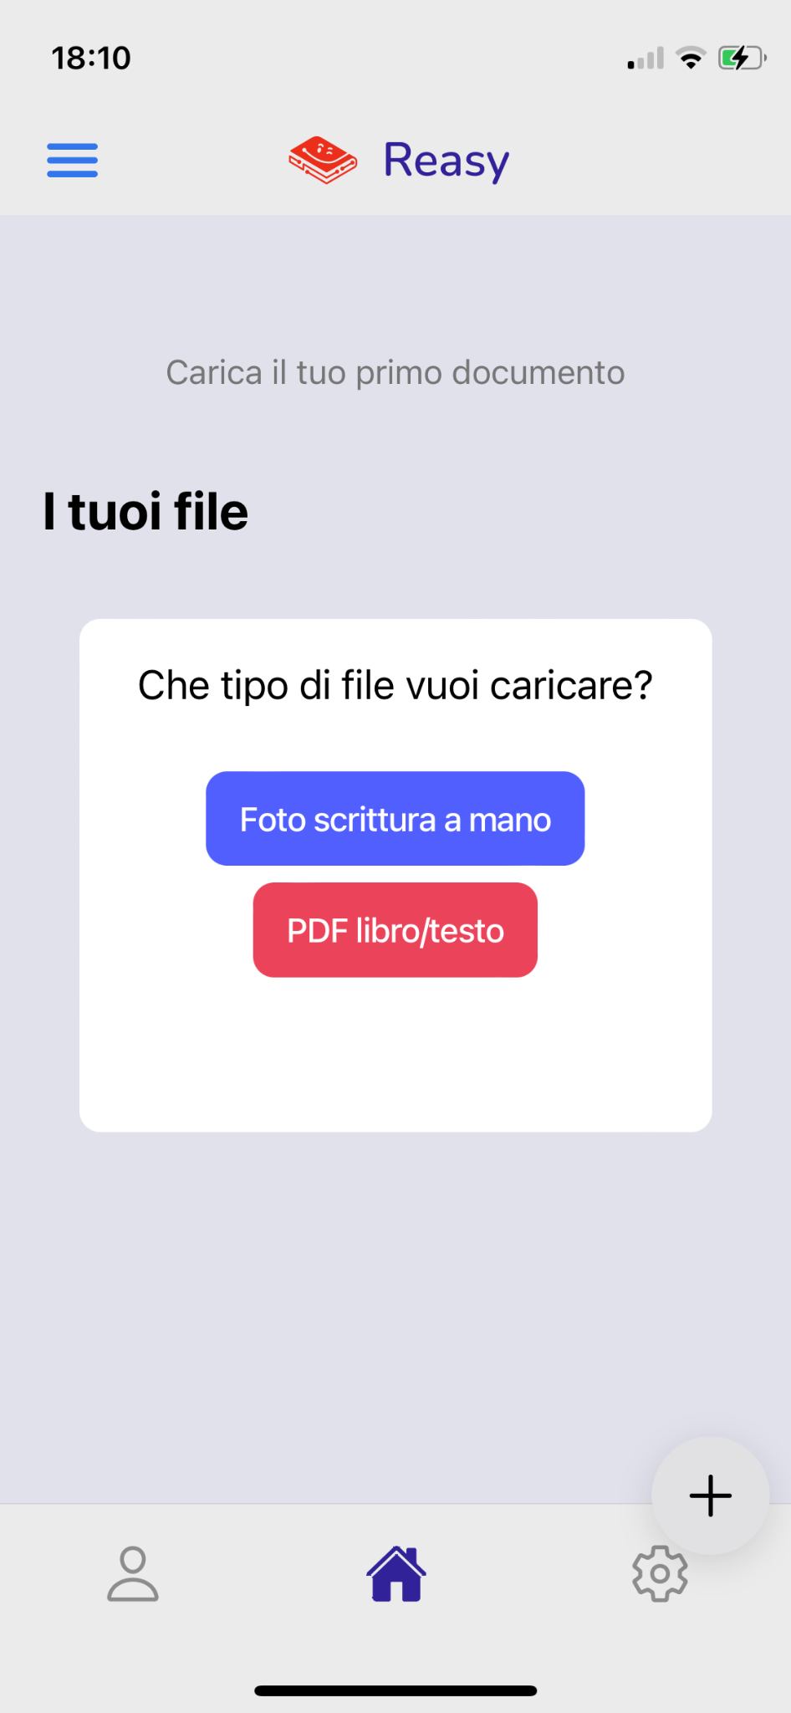

Caricamento file di testo
Pdf libro/testo o
foto degli appunti
scritti a mano
documento di testo con font
ad alta leggibilità e modificabile

Slide 47
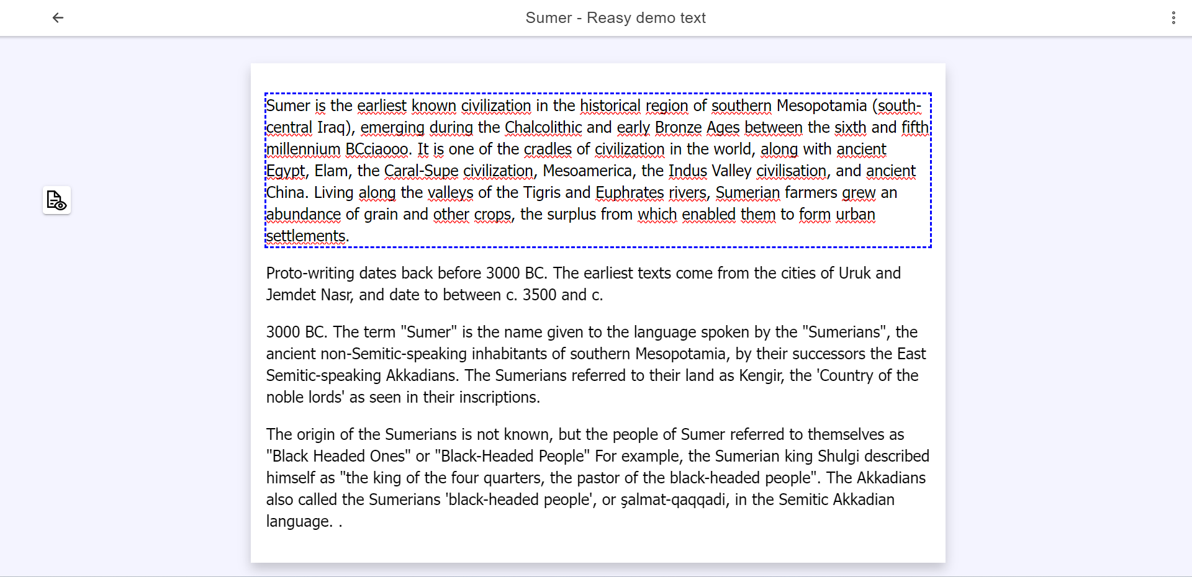
Modifica del testo

Slide 48
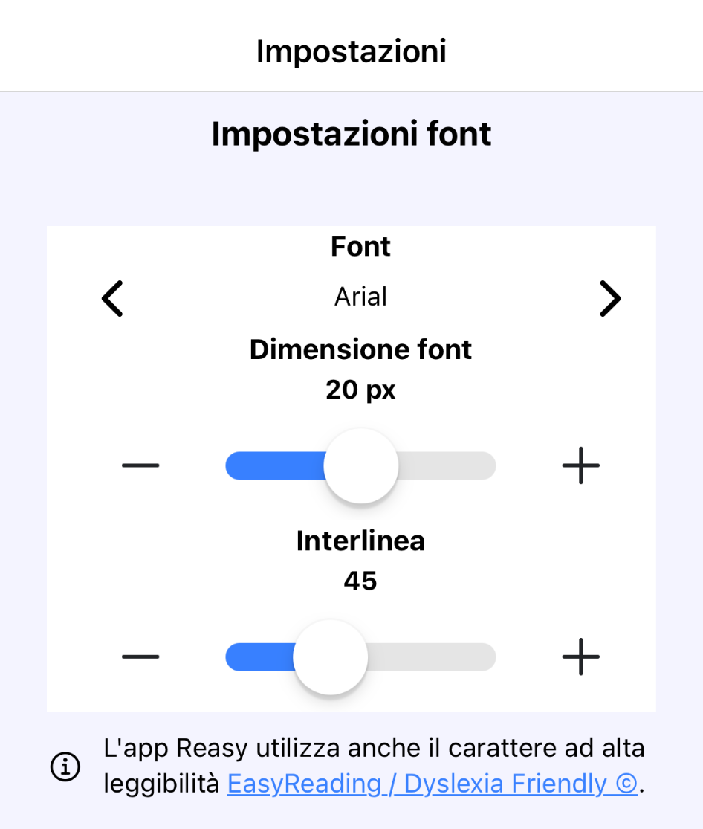
Modifica del carattere del testo
tipo di font
grandezza
interlinea

Slide 49
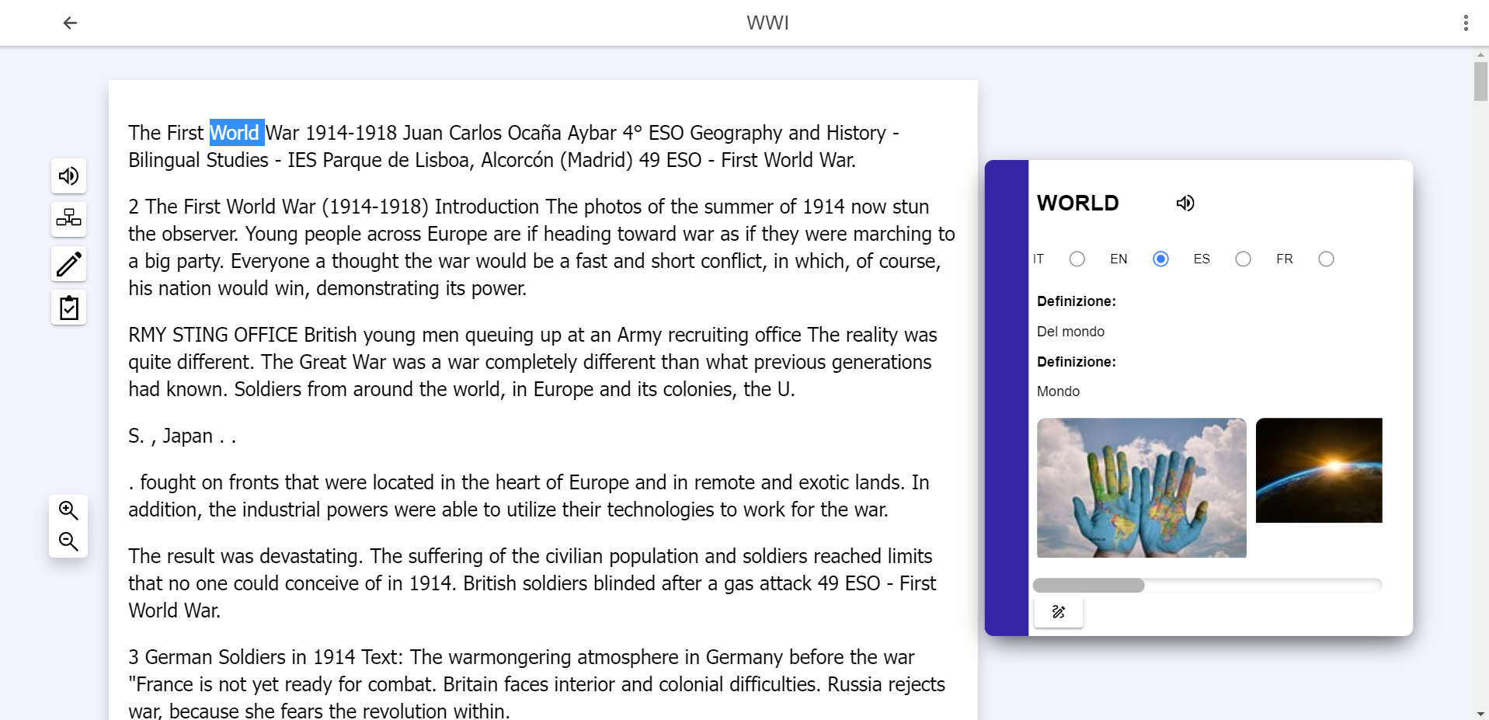
Analisi parola

Slide 50

Sintesi vocale
Dizionario
Associazione
Immagine
a una parola

Slide 51
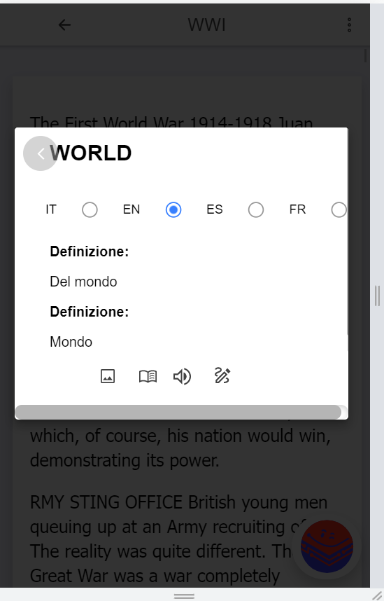
Dizionario
da mobile

Slide 52
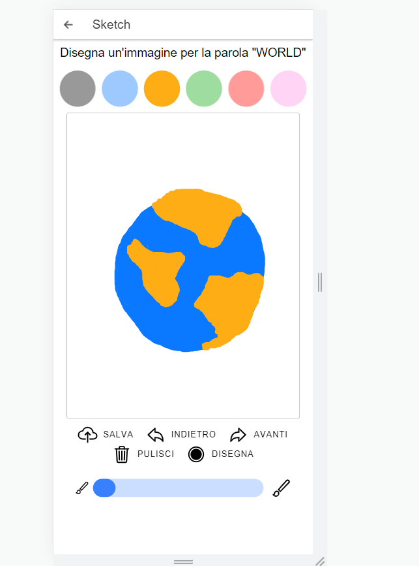
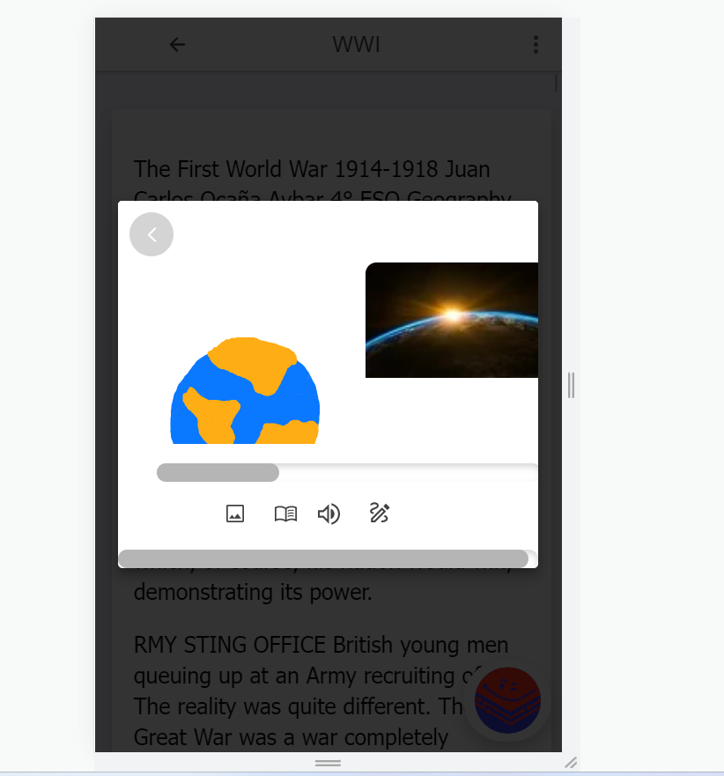
Disegno da associare a una parola
WORLD

Slide 53
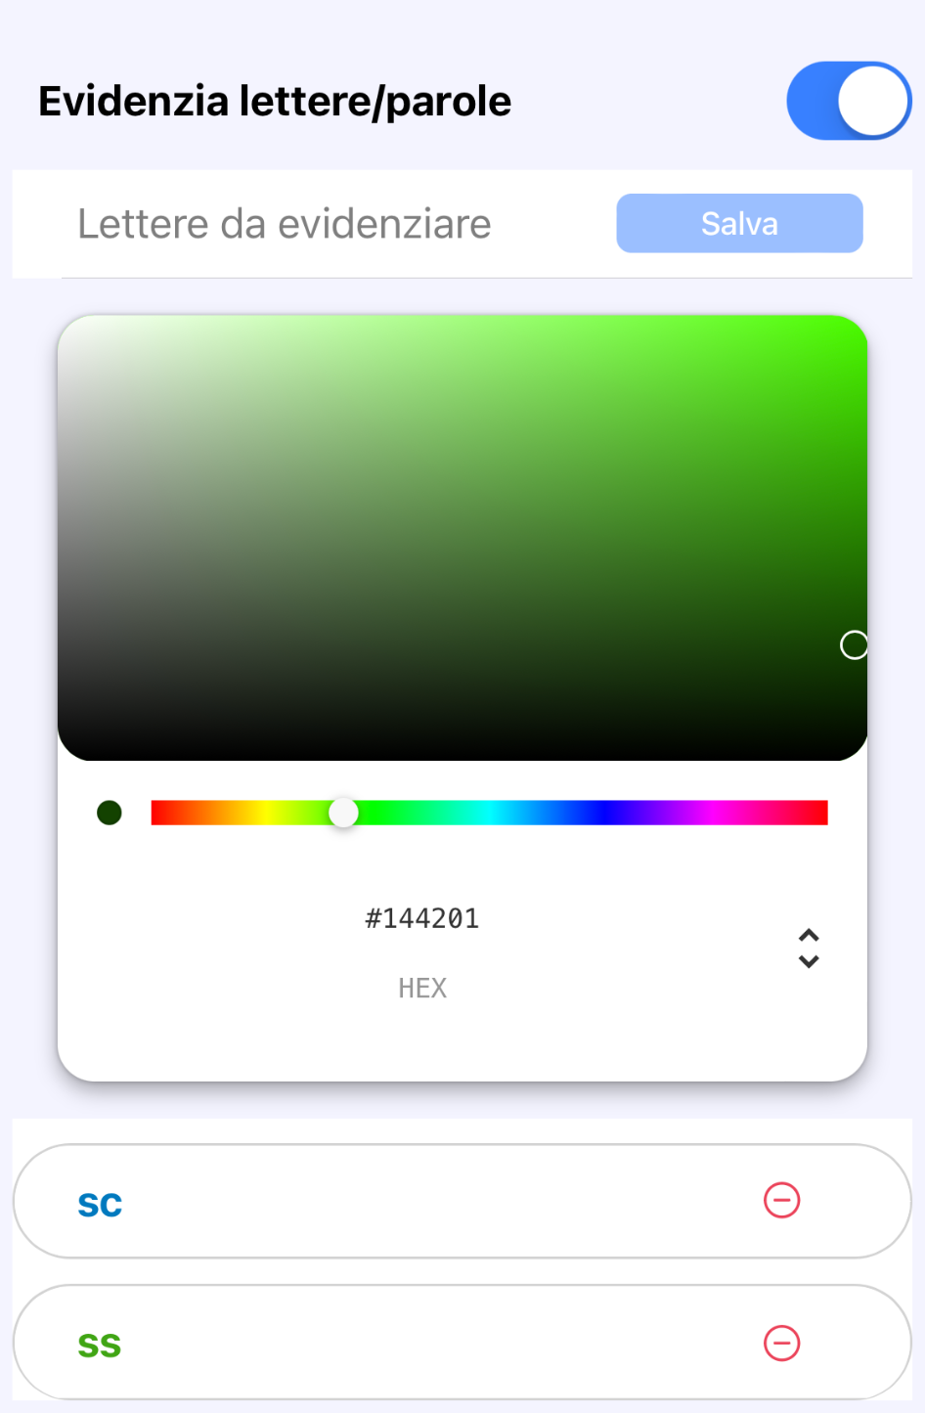
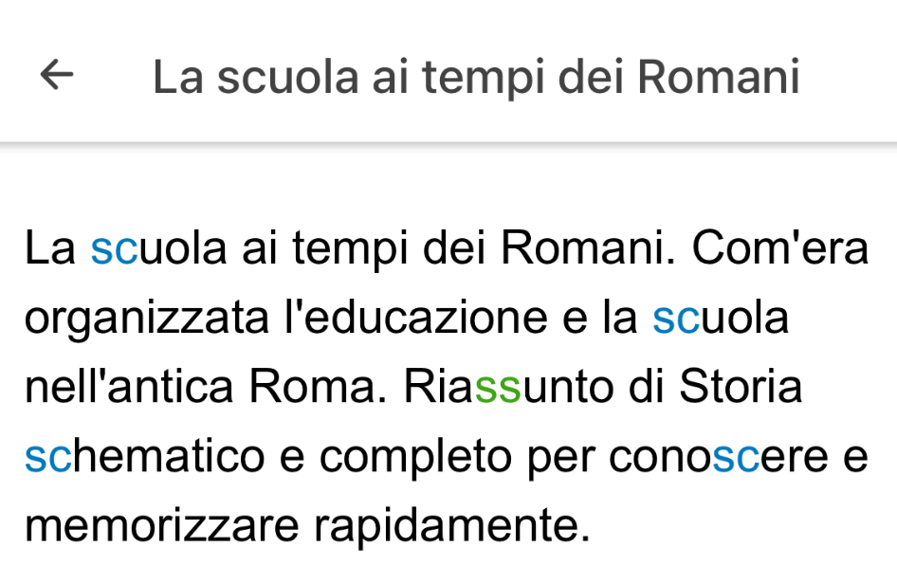
Evidenziazione di lettere o parole

Slide 54
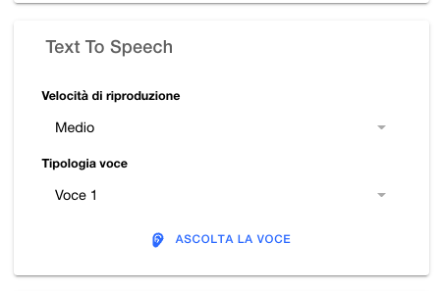
Sintesi vocale
velocità di riproduzione
voce (diverse tipologie)

Slide 55
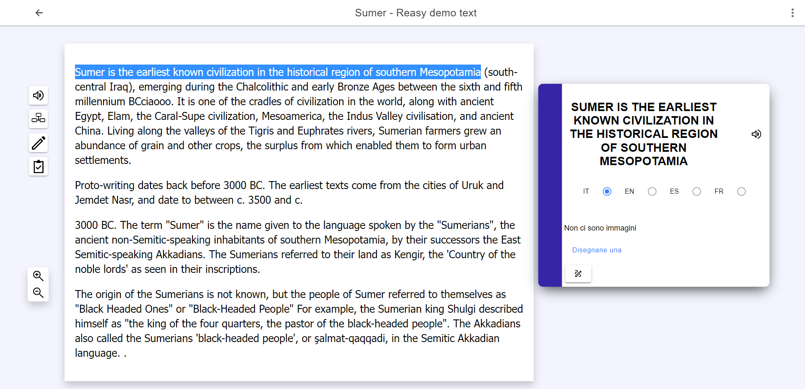
Ascolto di una frase selezionata o dell’intero testo

Slide 56
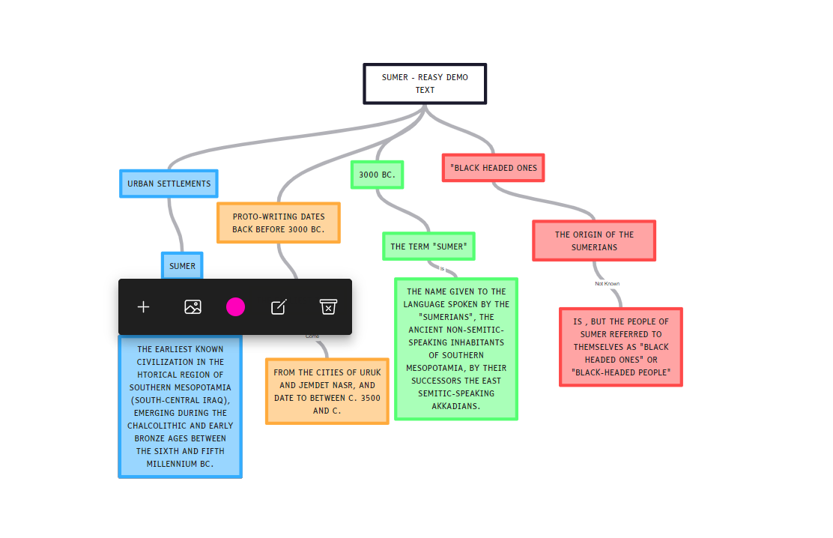
Creazione di mappe concettuali

Slide 57
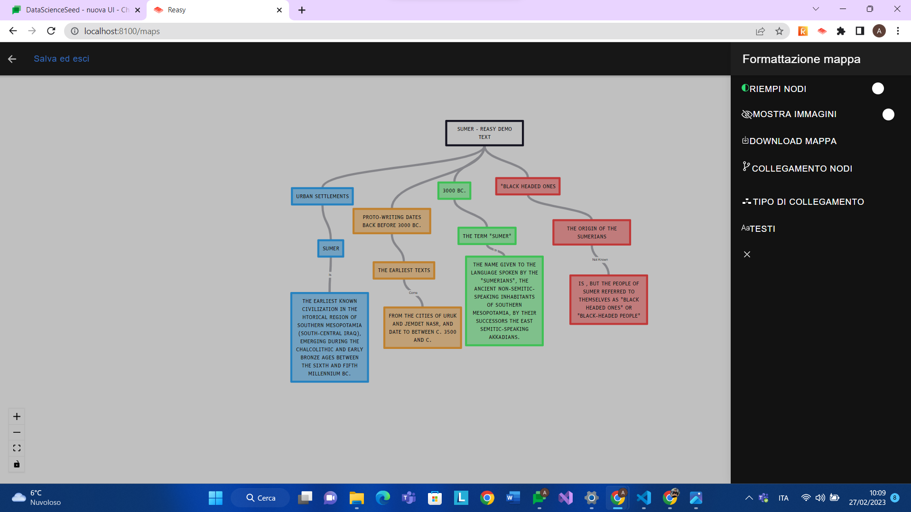
Creazione di mappe concettuali

Slide 58
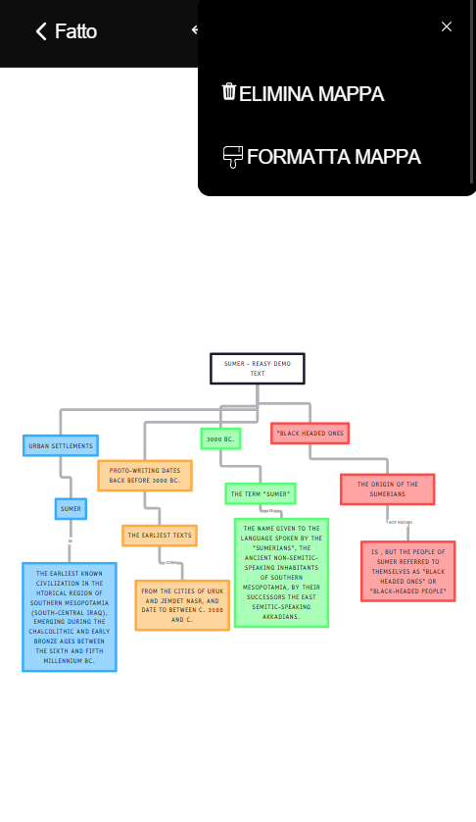
Creazione di mappe concettuali
da mobile

Slide 59




Slide 60

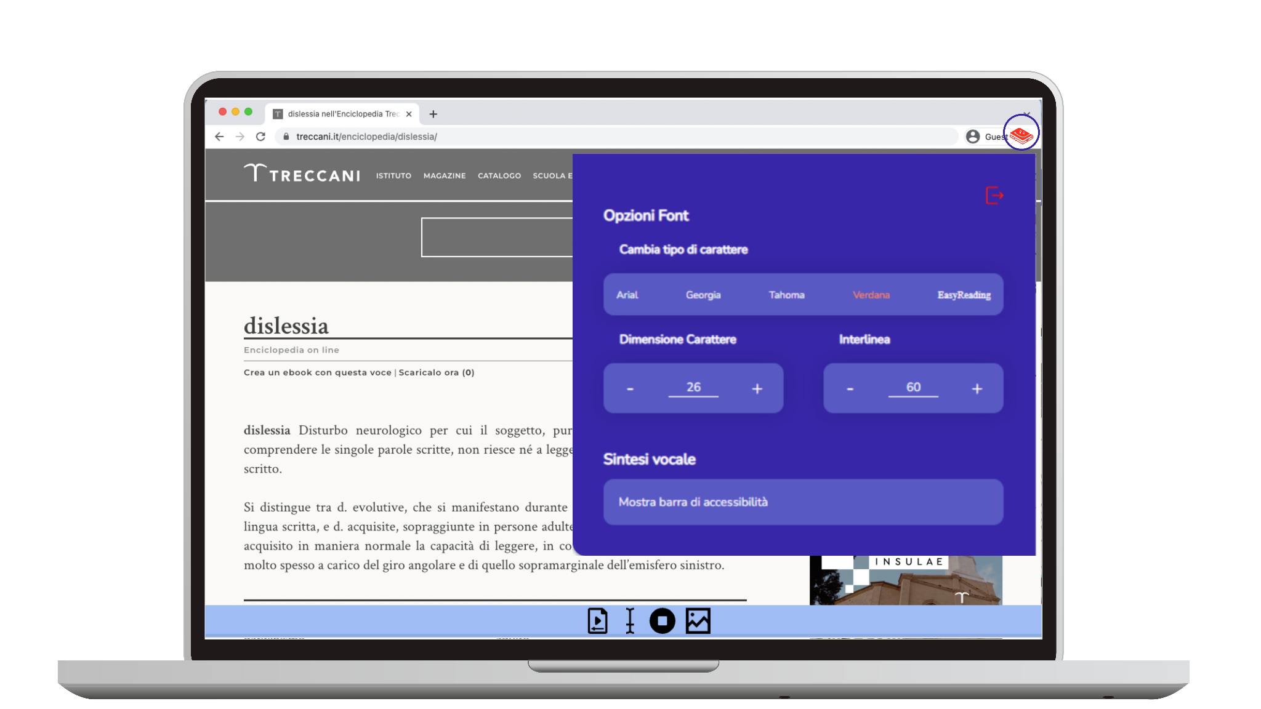
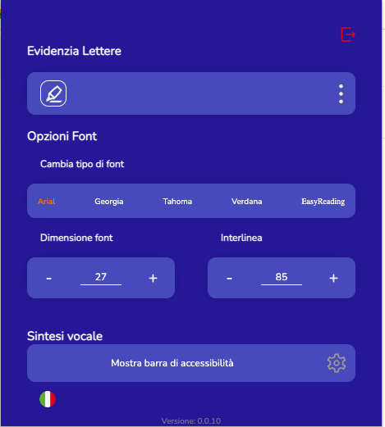
Reasy Chrome Extension

Slide 61
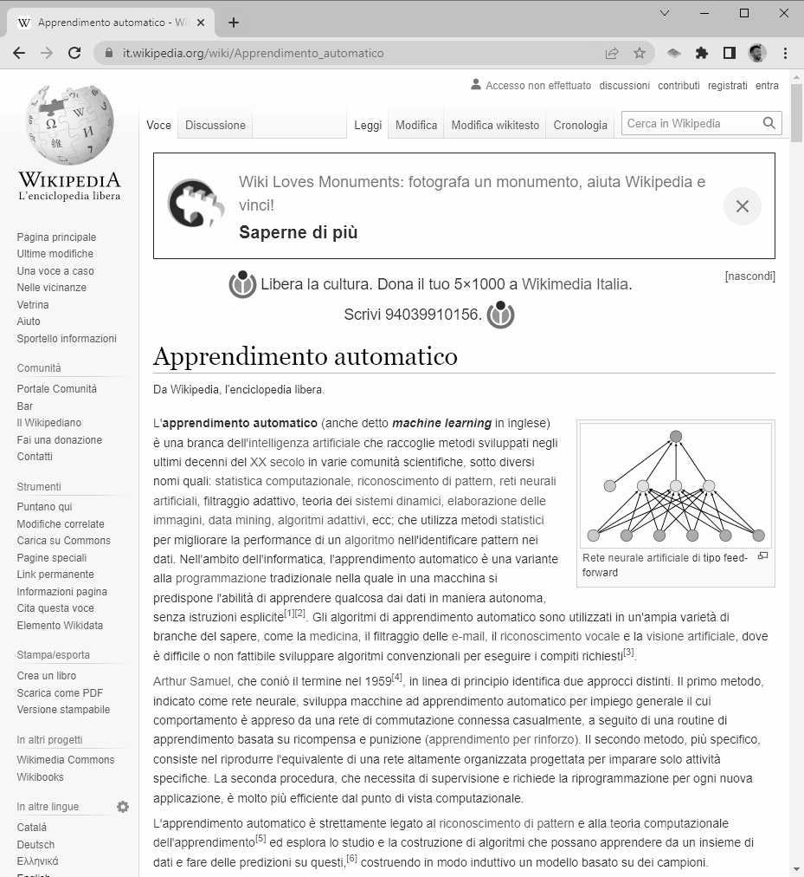
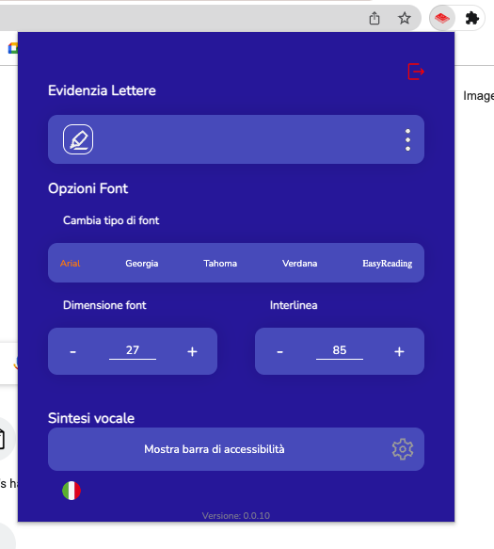

Slide 62
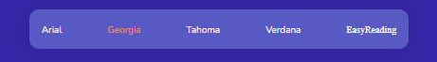
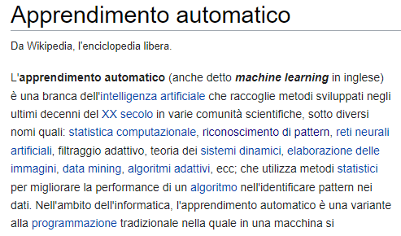
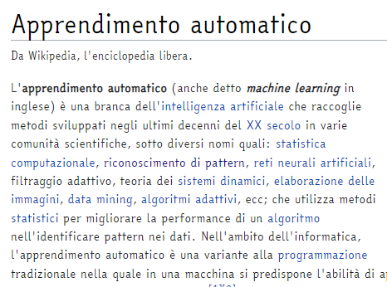
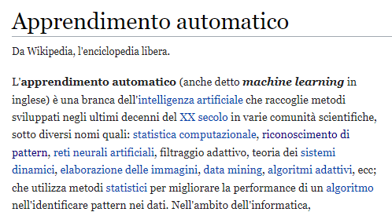
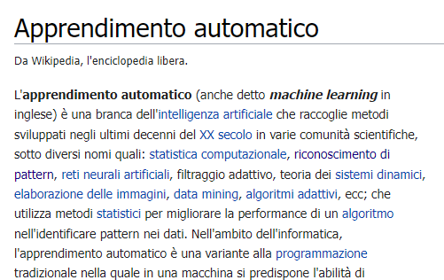
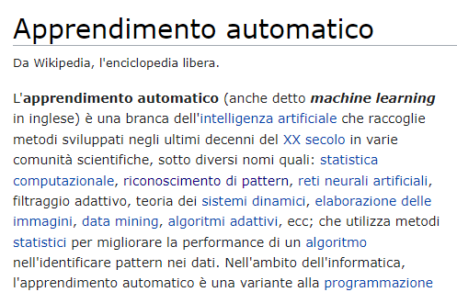

Slide 63
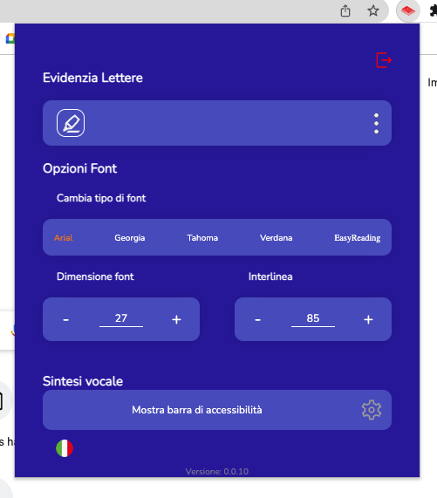

Slide 64
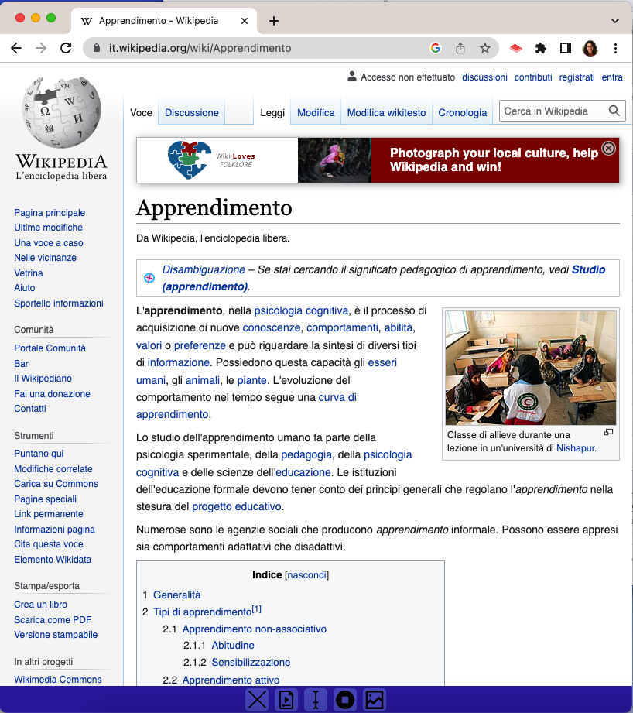

Slide 65
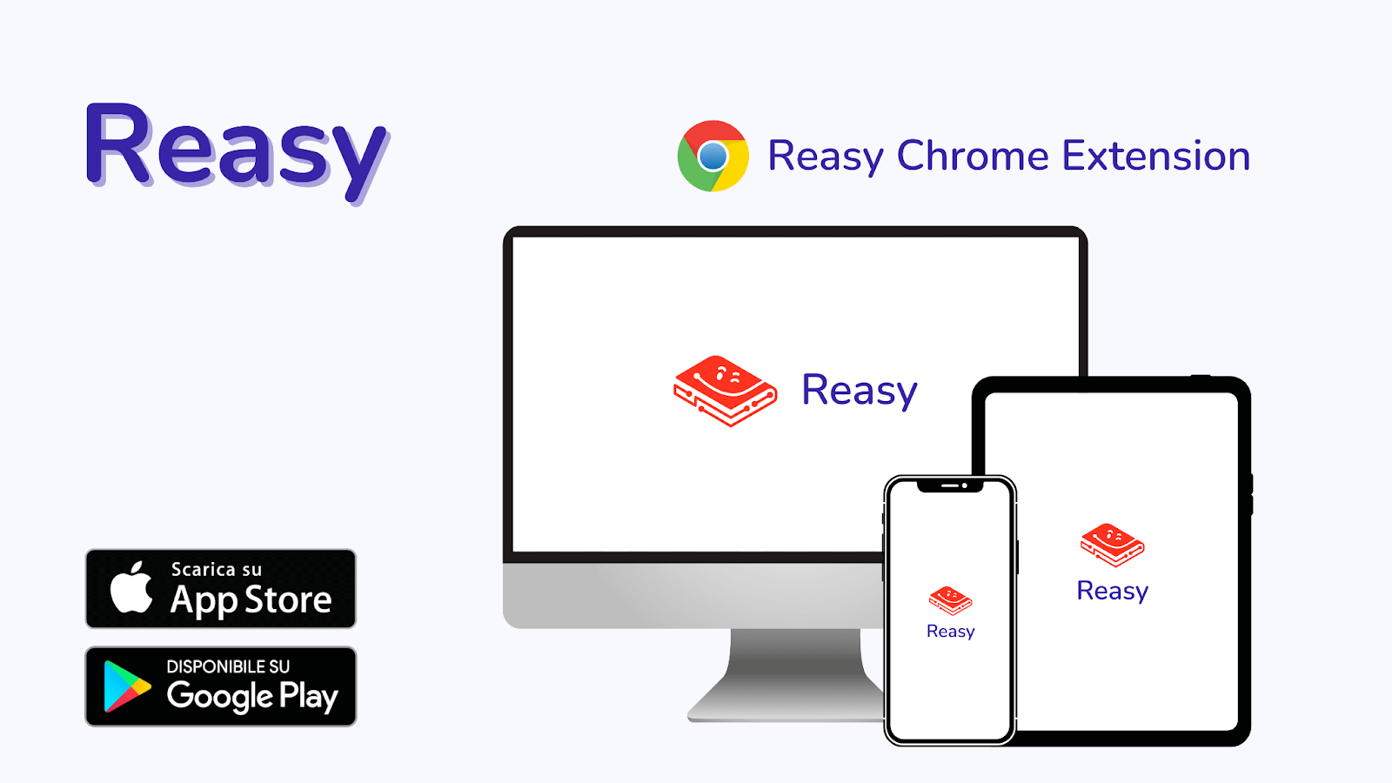

Slide 66
Grazie per l’attenzione

Slide 67





Contatti
contact@tech4all.ai
+39 366 112 6799
https://tech4all.ai/
Tech4All
@tech4all.ai

